Slide 1


CSE332: Data Abstractions Section 4
HyeIn Kim
CSE 331 Slides
Winter 2013

Slide 2
Section Agenda
Project 2: Shake-n-Bacon
- More Generics
- Comparator
- Inheritance review
- Iterator / Anonymous class
- JUnit Testing & Other Debugging tools
Project1 Feedback
B-Tree, HW2, HW3 question

Slide 3
Project 2
Shake-n-Bacon

Slide 4
Word Frequency Analysis
Phase A: Implement 3 ADTs
- Due next Wednesday, Feb 6
- Word frequency analysis using different DataCounters
AVLTree
MoveToFrontList
FourHeap
DataCount
data: Hamlet
count: 67
DataCount
data: Apple
count: 21
DataCount
data: water
count: 33

Slide 5
Generics
Generic Arrays & Wildcard

Slide 6
Generic Arrays
Field & variable can have generic array type
E[] elemArray;
Cannot create new generic array
E[] elemArray = new E[INITIAL_CAPACITY]; // Error
- Arrays need to “know their element type”
- Type “E” is unknown type
Workaround with Object[] - Unavoidable warning
E[] elemArray = (E[]) new Object[INITIAL_CAPACITY];
// Generates warning, but ok

Slide 7
Array of Parameterized type
Cannot create array of parameterized type
DataCount<E>[] dCount = new DataCount<E>[SIZE]; //Error
Object[] does not work - ClassCastException
DataCount<E>[] dCount = (DataCount<E>)
new Object[SIZE]; //Exception
- Arrays need to “know their element type”
- Object not guaranteed to be DataCount
Specify it will always hold “DataCount”
DataCount<E>[] dCount = (DataCount<E>)
new DataCount[SIZE]; // ok

Slide 8
Generics & Inner Class
Do not re-define type parameter
class OuterClass<E> {
class InnerClass<E> {}
} // No ☹
- Works, but not what you want!!
- Analogous of local variable shading field
class SomeClass {
int myInt;
void someMethod() {
int myInt = 3;
myInt ++;
} // Not the field
}
class OuterClass<E> {
class InnerClass {}
} // Yes ☺
class OuterClass<E> {
E myField;
class InnerClass<E> {
...
E data = myField;
} // Not the same type!!
}

Slide 9
Generic Methods
A method can be generic when the class is not
public static <E> void insertionSort
(E[] array, Comparator<E> comparator);
- Define the type variable at the method
More generics
http://docs.oracle.com/javase/tutorial/java/generics/index.html

Slide 10
Wildcard
Used to denote super/subtype of type parameter
Upper bounded wildcard: <? extends E>
- E and every subtype (subclass) of E
Lower bounded wildcard: <? super E>
- E and every supertype (superclass) of E
Consider <? extends E> for parameters,
<? super E> for return type
- The only use in this project is with comparator
public BinarySearchTree(Comparator<? super E> c);

Slide 11
Inheritance
Superclass & Interface

Slide 12
Interface & Inheritance
Interface provides list of methods a class
promise to implement
- Inheritance: is-a relationship and code sharing.
AVLTree can be treated as BinarySearchTree and inherits code.
- Interfaces: is-a relationship without code sharing.
FourHeap can be treated as PriorityQueue but inherits no code.
Inheritance provides code reuse Style Points!!
- Take advantage of inherited methods
- Do not re-implement already provided functionality
- Override only when it is neccessary

Slide 13
Comparing Objects
Comparable & Comparator

Slide 14
Comparing objects
Operators <, > do not work with objects in Java
Two ways of comparing:
1. Implement Comparable Interface
- Natural Ordering: 1, 2, 3, 4 …
- One way of ordering
2. Use Comparator <- Project 2
- Many ways of ordering

Slide 15
The Comparable interface
public interface Comparable<T> {
public int compareTo(T other);
}
A call of A.compareTo(B) should return:
a value < 0 if A comes "before" B in the ordering,
a value > 0 if A comes "after" B in the ordering,
or exactly 0 if A and B are considered "equal" in the ordering.

Slide 16
What's the "natural" order?
public class Rectangle implements Comparable<Rectangle> {
private int x, y, width, height;
public int compareTo(Rectangle other) {
// ...?
}
}
What is the "natural ordering" of rectangles?
By x, breaking ties by y?
By width, breaking ties by height?
By area? By perimeter?
Do rectangles have any "natural" ordering?
Might we ever want to sort rectangles into some order anyway?

Slide 17
Comparator interface
public interface Comparator<T> {
public int compare(T first, T second);
}
Interface Comparator:
- External object specifies comparison function
- Can define multiple orderings

Slide 18
Comparator examples
public class RectangleAreaComparator
implements Comparator<Rectangle> {
// compare in ascending order by area (WxH)
public int compare(Rectangle r1, Rectangle r2) {
return r1.getArea() - r2.getArea();
}
}
public class RectangleXYComparator
implements Comparator<Rectangle> {
// compare by ascending x, break ties by y
public int compare(Rectangle r1, Rectangle r2) {
if (r1.getX() != r2.getX()) {
return r1.getX() - r2.getX();
} else {
return r1.getY() - r2.getY();
}
}
}

Slide 19
Using Comparators
TreeSet and TreeMap can accept a Comparator parameter.
Comparator<Rectangle> comp = new RectangleAreaComparator();
Set<Rectangle> set = new TreeSet<Rectangle>(comp);
Searching and sorting methods can accept Comparators.
Arrays.binarySearch(array, value, comparator)
Arrays.sort(array, comparator)
Collections.binarySearch(list, comparator)
Collections.max(collection, comparator)
Collections.min(collection, comparator)
Collections.sort(list, comparator)
Methods are provided to reverse a Comparator's ordering:
Collections.reverseOrder()
Collections.reverseOrder(comparator)

Slide 20
Iterator
objects that traverse collections

Slide 21
Iterator
Object that allows traverse elements of collection
- Anonymous class: Combined class declaration and instantiation.
public SimpleIterator<DataCount<E>> getIterator() {
return new SimpleIterator<DataCount<E>>() {
// Returns true if there are more elements to examine
public boolean hasNext() {
...
}
// Returns the next element from the collection
public DataCount<E> next() {
if(!hasNext()) {
throw new NoSuchElementException();
}
...
}
};
}

Slide 22
JUnit
Unit testing: Looking for errors in a subsystem in isolation

Slide 23
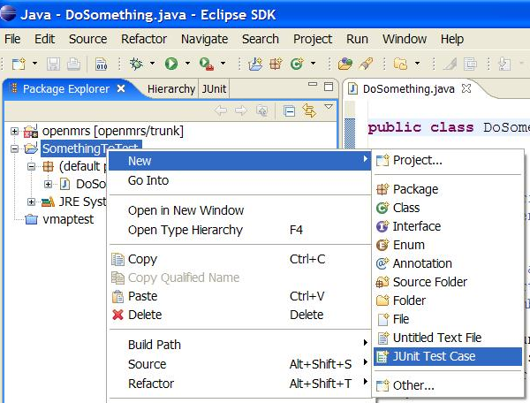
JUnit and Eclipse
To add JUnit to an Eclipse project, click:
Project → Properties → Build Path → Libraries → Add Library... → JUnit → JUnit 4 → Finish
To create a test case:
right-click a file and choose New → Test Case
or click File → New → JUnit Test Case
Eclipse can create stubs of method tests for you.

Slide 24
A JUnit test class
import org.junit.*;
import static org.junit.Assert.*;
public class name {
...
@Test
public void name() { // a test case method
...
}
}
A method with @Test is flagged as a JUnit test case.
All @Test methods run when JUnit runs your test class.

Slide 25
JUnit assertion methods
Each method can also be passed a string to display if it fails:
e.g. assertEquals("message", expected, actual)
Why is there no pass method?
assertTrue(test) | fails if the boolean test is false
assertFalse(test) | fails if the boolean test is true
assertEquals(expected, actual) | fails if the values are not equal
assertSame(expected, actual) | fails if the values are not the same (by ==)
assertNotSame(expected, actual) | fails if the values are the same (by ==)
assertNull(value) | fails if the given value is not null
assertNotNull(value) | fails if the given value is null
fail() | causes current test to immediately fail

Slide 26
Trustworthy tests
Test one thing at a time per test method.
10 small tests are much better than 1 test 10x as large.
Each test method should have few (likely 1) assert statements.
If you assert many things, the first that fails stops the test.
You won't know whether a later assertion would have failed.
Tests should avoid logic.
minimize if/else, loops, switch, etc.
Torture tests are okay, but only in addition to simple tests.

Slide 27
Naming test cases
public class DateTest {
@Test
public void test_addDays_withinSameMonth_1() {
Date actual = new Date(2050, 2, 15);
actual.addDays(4);
Date expected = new Date(2050, 2, 19);
assertEquals("date after +4 days", expected, actual);
}
// give test case methods really long descriptive names
@Test
public void test_addDays_wrapToNextMonth_2() {
Date actual = new Date(2050, 2, 15);
actual.addDays(14);
Date expected = new Date(2050, 3, 1);
assertEquals("date after +14 days", expected, actual);
}
// give descriptive names to expected/actual values
}

Slide 28
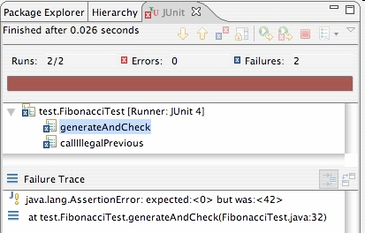
Good assertion messages
public class DateTest {
@Test
public void test_addDays_addJustOneDay_1() {
Date actual = new Date(2050, 2, 15);
actual.addDays(1);
Date expected = new Date(2050, 2, 16);
assertEquals("adding one day to 2050/2/15",
expected, actual);
}
...
}
// JUnit will already show
// the expected and actual
// values in its output;
//
// don't need to repeat them
// in the assertion message

Slide 29
Well-structured assertions
public class DateTest {
@Test
public void test1() {
Date d = new Date(2050, 2, 15);
d.addDays(4);
assertEquals(2050, d.getYear()); // expected
assertEquals(2, d.getMonth()); // value should
assertEquals(19, d.getDay()); // be at LEFT
}
@Test
public void test2() {
Date d = new Date(2050, 2, 15);
d.addDays(14);
assertEquals("year after +14 days", 2050, d.getYear());
assertEquals("month after +14 days", 3, d.getMonth());
assertEquals("day after +14 days", 1, d.getDay());
} // test cases should usually have messages explaining
} // what is being checked, for better failure output

Slide 30
Expected answer objects
public class DateTest {
@Test
public void test1() {
Date d = new Date(2050, 2, 15);
d.addDays(4);
Date expected = new Date(2050, 2, 19);
assertEquals(expected, d); // use an expected answer
} // object to minimize tests
// (Date must have toString
@Test // and equals methods)
public void test2() {
Date d = new Date(2050, 2, 15);
d.addDays(14);
Date expected = new Date(2050, 3, 1);
assertEquals("date after +14 days", expected, d);
}
}

Slide 31
Tests with a timeout
@Test(timeout = 5000)
public void name() { ... }
The above method will be considered a failure if it doesn't finish running within 5000 ms
private static final int TIMEOUT = 2000;
...
@Test(timeout = TIMEOUT)
public void name() { ... }
Times out / fails after 2000 ms

Slide 32
Testing for exceptions
@Test(expected = ExceptionType.class)
public void name() {
...
}
Will pass if it does throw the given exception.
If the exception is not thrown, the test fails.
Use this to test for expected errors.
@Test(expected = ArrayIndexOutOfBoundsException.class)
public void testBadIndex() {
ArrayIntList list = new ArrayIntList();
list.get(4); // should fail
}

Slide 33
Setup and teardown
@Before
public void name() { ... }
@After
public void name() { ... }
methods to run before/after each test case method is called
@BeforeClass
public static void name() { ... }
@AfterClass
public static void name() { ... }
methods to run once before/after the entire test class runs

Slide 34
Flexible helpers
public class DateTest {
@Test(timeout = DEFAULT_TIMEOUT)
public void addDays_multipleCalls_wrapToNextMonth2x() {
Date d = addHelper(2050, 2, 15, +14, 2050, 3, 1);
addhelper(d, +32, 2050, 4, 2);
addhelper(d, +98, 2050, 7, 9);
}
// Helpers can box you in; hard to test many calls/combine.
// Create variations that allow better flexibility
private Date addHelper(int y1, int m1, int d1, int add,
int y2, int m2, int d2) {
Date date = new Date(y, m, d);
addHelper(date, add, y2, m2, d2);
return d;
}
private void addHelper(Date date, int add,
int y2, int m2, int d2) {
date.addDays(add);
Date expect = new Date(y2, m2, d2);
assertEquals("date after +" + add + " days", expect, d);
}
...

Slide 35

Test case "smells"
Tests should be self-contained and not care about each other.
"Smells" (bad things to avoid) in tests:
Constrained test order : Test A must run before Test B. (usually a misguided attempt to test order/flow)
Tests call each other : Test A calls Test B's method (calling a shared helper is OK, though)
Mutable shared state : Tests A/B both use a shared object. (If A breaks it, what happens to B?)

Slide 36
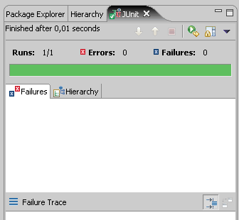
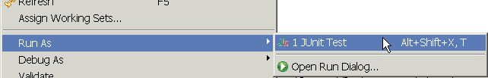
Running a test
Right click it in the Eclipse Package Explorer at left; choose:
Run As → JUnit Test
The JUnit bar will show green if all tests pass, red if any fail.
The Failure Trace shows which tests failed, if any, and why.

Slide 37
JGrasp Debugger
Visual Tool for tree/list debugging

Slide 38
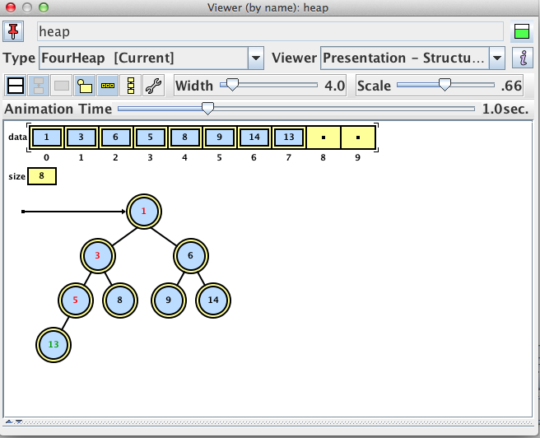
JGrasp Debugger

Slide 39
Project 1 Feedback & Project 2 Tips
Style Guide

Slide 40
Style Guide
Style Points are 1/3 of your grade!!
- Grade breakdown: 1/3 correctness, 1/3 write up, 1/3 style
- In industry, you’ll be always working with other people
- Readability and Conciseness of code is very very important!!!
Make sure you read style guide
- Style guide: http://www.cs.washington.edu/education/courses/cse332/13wi/projects/style.txt
- Comment guide: http://www.cs.washington.edu/education/courses/cse332/13wi/projects/commenting.pdf
- Java Convention: http://www.oracle.com/technetwork/java/codeconvtoc-136057.html

Slide 41
Project 1 Feedback
Make sure your code compile!!
- No correctness point if your code doesn’t compile
- Be sure to take out package statement
Comment your code
- Follow guide: http://www.cs.washington.edu/education/courses/cse332/13wi/projects/style.txt
Use descriptive variable / method names
- If variable points to stack top, name it like ‘stackTop’, not ‘l’ or ‘g’
Use specify private / public appropriately
- Do not just omit this!

Slide 42
Project 1 Feedback
Initialize all non-static fields in constructor
private int size = 0; //☹
private int size; Public Stack() { size = 0; } //☺
Make your code as concise as possible
end = end + 1; // ☹ ☹ ☹
this.isEmpty();
front = this.new Node(d, front);
if(front == null){
front = new ListNode(d);
}else{
ListNode newNode = new ListNode(d, front);
front = newNode;
}
end ++; // ☺ ☺ ☺
isEmpty();
front = new Node(d, front);
front = new ListNode(d, front);

Slide 43
Project 1 Feedback
Use constants for fixed constants
private static final int INITIAL_CAPACITY = 10;
private static final int RESIZE_FACTOR = 2;
Use Boolean zen
if(size==0){ return true; }else{ return false; }//☹
return size == 0; //☺
Maximize code reuse, minimize redundancy
- For example, calling peek() inside of pop()
- Using isEmpty() instead of size == 0

Slide 44
Project 1 Feedback
Use @Override when overriding
Do not leave warning generating code
- Unless you know why it is there and why it is unavoidable
(Generic array, casting for AVLNode)
- Suppress warnings on method/variable, but not on whole class
Avoid inefficient design
- ArrayStack: Insert into stackArray[0], shifting all elements
Avoid unnecessary field
private int size = stackArray.length;

Slide 45
Project 2 Tips
Take advantage of superclass’s implementation
when writing subclass
Minimize casting
- Remember AVLNode is-a BSTNode
- AVLNode can be treated as BSTNode, only except when
accessing its height information
- Consider some private function like: height(node)
updateHeight(node)

